Slide 1
STRETCH: REACT ROUTER
https://github.com/tnt-summer-academy/Curriculum-2022/blob/main/Stretch%20topics/ReactRouter.md
Created for Microsoft / TNTs

Slide 2
Learning objectives
TNTs will learn how to do multi-page navigation in React using React Router
TNTs will experiment with dynamic routing
TNTs will learn how data can be passed from one page to the next one
TNTs will learn about how React Router Hooks provide specific ways of handling the router state
TNTs will see how to use a navigation bar and implement routing with it
TNTs will put React Router to work

Slide 3
Organisation of the session

Slide 4
Organisation of the session
Slides
2 demos
One that demos React Router Hooks
https://github.com/tnt-summer-academy/Samples/tree/main/Stretch/router-javascript-demo
https://github.com/tnt-summer-academy/Samples/tree/main/Stretch/router-javascript-demo-skeleton (Skeleton code)
One that implements a store FabShop
Uses a Bootstrap React - Navbar, Form, Button
Use fakeStoreApi to get API data into the app
https://github.com/tnt-summer-academy/Samples/tree/main/Stretch/router-nav-demo
QA

Slide 5
Resources
https://reactrouter.com/
https://fakestoreapi.com/docs
Videos
https://www.youtube.com/watch?v=Law7wfdg_ls&t=1032s
https://www.youtube.com/watch?time_continue=63&v=cKnc8gXn80Q&feature=emb_logo

Slide 6
PART 1
DISCUSSION
How was navigation implemented in YourShare?
How did you implement sending data from one page to another page?

Slide 7
YourShare
The state of App is defined as the currentPage
pages is an object that contains the different pages of the app
changePage is defined as a function props and used for any page component
changeStcreen is the function that transitions the app from one state to another , i.e. from one page to another

Slide 8
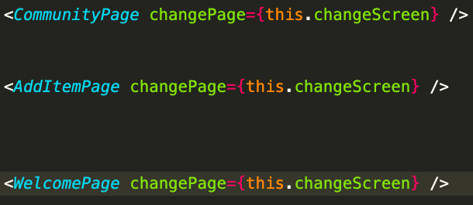
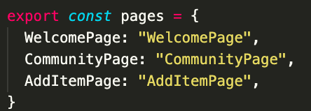
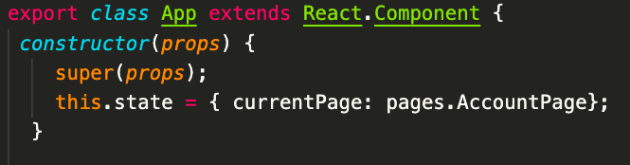
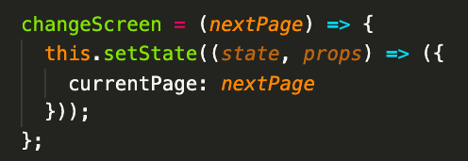
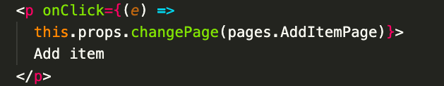
App.js
Passing the function changePage as a props to other components
List the pages
The state is the current page
In another component
Transition from one page to the other

Slide 9
Was this standard?
Why?

Slide 10
PART 2
REACT ROUTER

Slide 11
What do you remember of React Router?
Are you using it in your app?

Slide 12
React Router (v5)
React Router is a library that allows you to handle routes in a web app, using static and dynamic routing.
Dynamic routing takes place as the app is rendering on your machine and when routes are known at execution
React Router implements a component-based approach to routing. It provides different routing components according to the needs of the application and platform.
There are three primary categories of components in React Router:
Routers, like <BrowserRouter>, and <HashRouter>
Navigation, like <Link>, <NavLink>, and <Redirect>
Route matchers, like <Route>, and <Switch>
Using a Router is component-based and permits to see the path in the browser, e.g. localhost:3000/about

Slide 13
Static versus dynamic routing
Static routing means that the routes are declared as part of the app initialization before any rendering takes place.
localhost:3000/about
Dynamic routing means that that routing takes place as the app is rendering, not outside the running app. More than one piece of dynamic data can be passed to determine the route. With dynamic routing, the app can know how to respond to any possible url.
localhost:3000/item/6482232
localhost:3000/contact/John/NYC

Slide 14
BrowserRouter
import { BrowserRouter as Router} from "react-router-dom"
<BrowserRouter> aliased as Router is to set up your app to work with React Router by wrapping the app in <BrowserRouter> or <Router> element. Everything that gets rendered goes inside the element tag. It is used for an app that will respond to dynamic requests (any possible urls).
NB: HashRouters are used for static websites (predefined urls)

Slide 15
Steps to implement navigation
Implementing navigation goes through:
Choosing a router
Creating the routes (with corresponding matches)
Navigating between routes using links

Slide 16
How to create routes?
<Route> expects path as props. A route has 3 props that define what should be rendered:
component - renders a React component
render - function that returns a React element. It is useful for inline rendering
children - function that returns a React element and renders the children regardless whether the route’s path matches the current location
<Switch> is used to group routes. It will iterate over its <Route> children and render the one that matches the current pathname. We want to have only one route at a time.

Slide 17
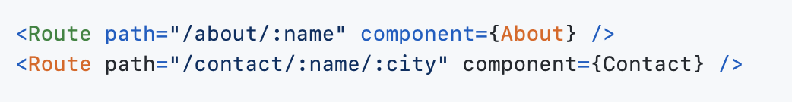
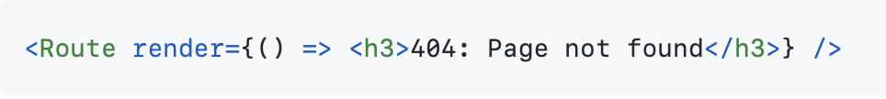
localhost:3000/contact
localhost:3000/about/John
localhost:3000/about/John/NYC
Any unknown url

Slide 18
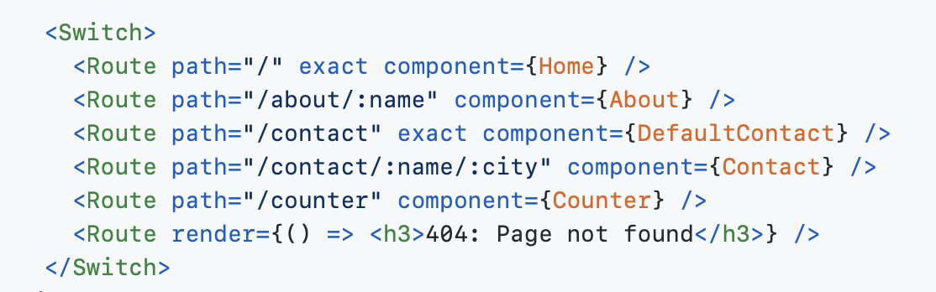
What route is matched in the following situations?
localhost:3000/contact
localhost:3000/contact/John/NYC
localhost:3000
1
2
3
4
5
6

Slide 19
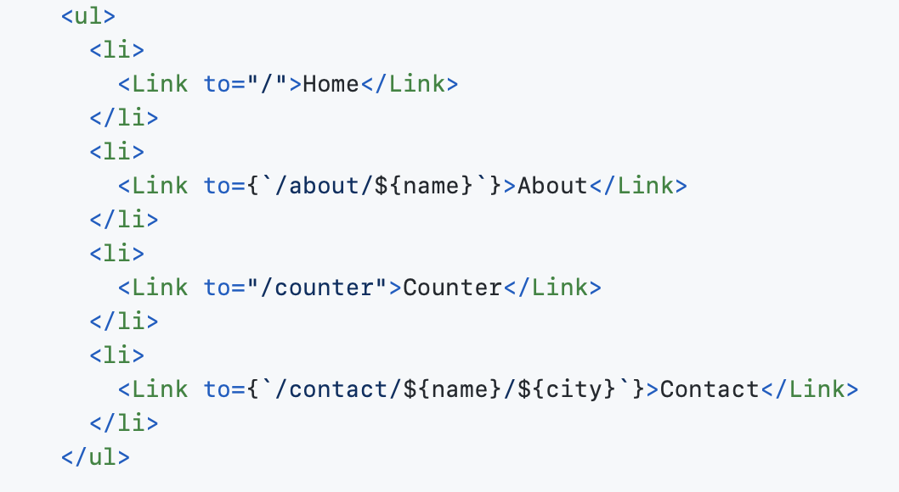
<Link>
<Link> tells the app how to navigate between pages.
<Link> prevents from loading the whole page.
It only loads what is specified in the link. It is different from using the anchor tag <a>. It updated the url and renders the appropriate page.
<Link> uses the prop to to describe the location to navigate to.

Slide 20
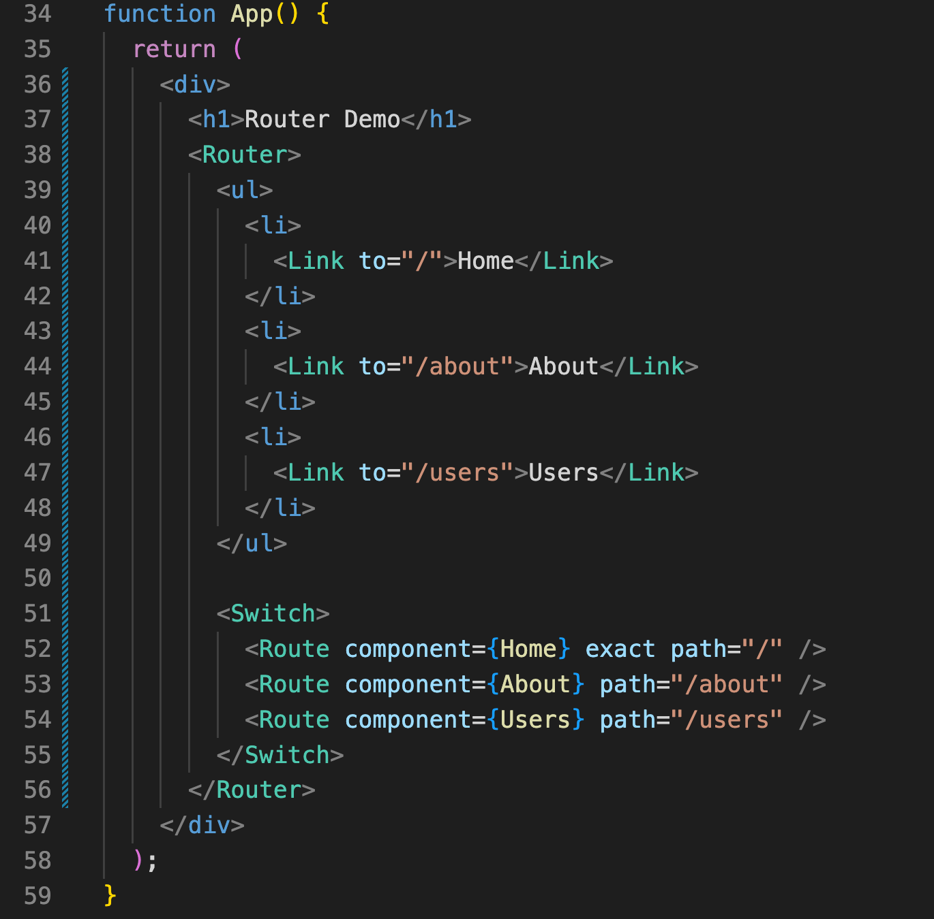
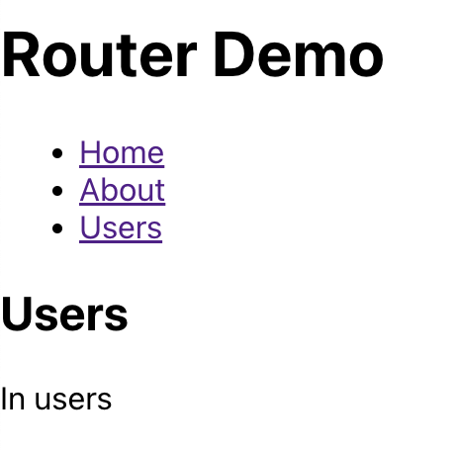
All together

Slide 21
PART 3
REACT ROUTER HOOKS

Slide 22
What hooks did you learn about so far?

Slide 23
useParams
useLocation
useHistory

Slide 24
useParams
useParams - returns an object of key/value pairs of URL parameters.
It is used to access props.match.params of the current <Route>
Thus, params can also be accessed using props.match.params.nameofparameter

Slide 25
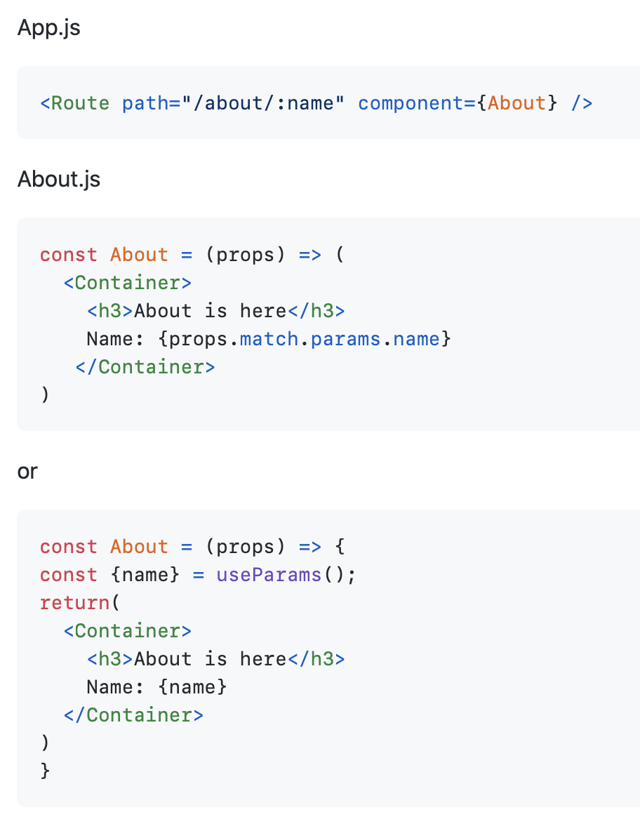
localhost:3000/about/John

Slide 26
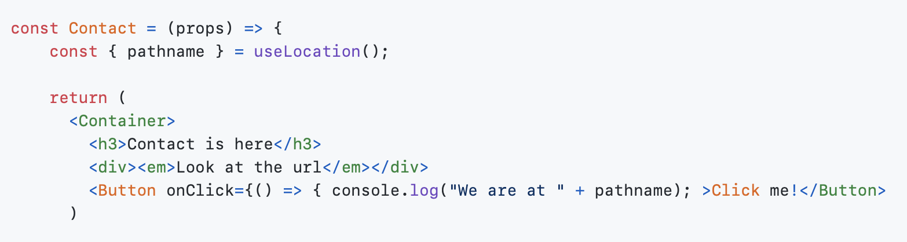
useLocation
useLocation - returns the location object that represents the current url

Slide 27
useHistory
useHistory provides access to the history instance that may be used to navigate. history refers to the browser history
History objects have the following properties and methods:
length - (number) The number of entries in the history stack
action - (string) The current action (PUSH, REPLACE, or POP)
location - (object) The current location. May have the following properties:
pathname - (string) The path of the URL
state - (object) location-specific state that was provided to e.g. push(path, state) when this location was pushed onto the stack. Only available in browser and memory history.
search/has
push(path, [state]) - (function) Pushes a new entry onto the history stack
replace(path, [state]) - (function) Replaces the current entry on the history stack
go(n) / goBack() / goForward() / block(prompt)

Slide 28
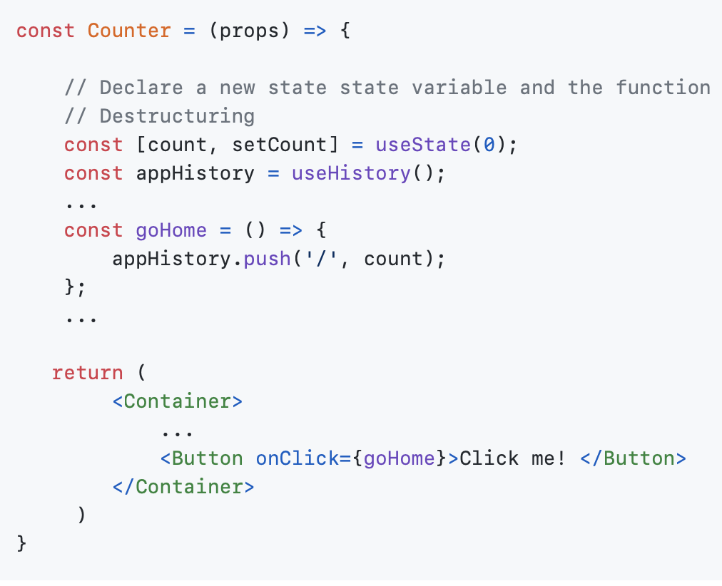
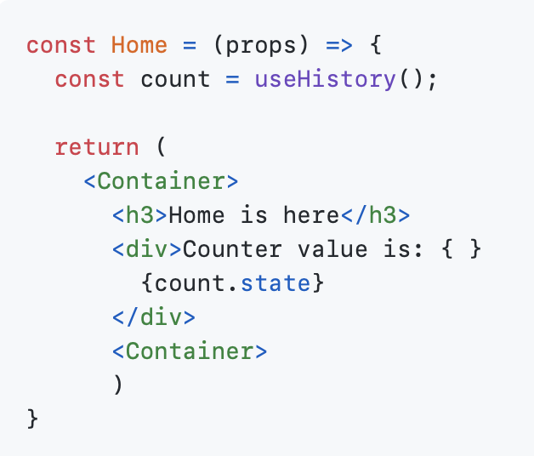
Counter.js
Home.js
We go to Home and pass the state
We use the history
We could also use props.location.state.count

Slide 29
What are the limitations of React Router to pass data?

Slide 30

BREAK

Slide 31
PART 4
SETTING UP

Slide 32
Setting up
Be sure to be in the correct directory!
npm install
npm install react-router-dom@5.3.3
npm install react-bootstrap bootstrap@4.6.0
(because we will be using Bootstrap React)
npm install react-async --save
(because we will fetch data online when using fakeStoreApi)
npm start
To launch the app

Slide 33
PART 5 FIRST EXAMPLE

Slide 34
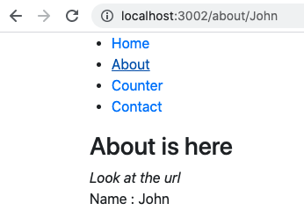
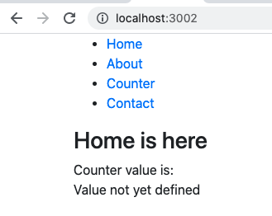
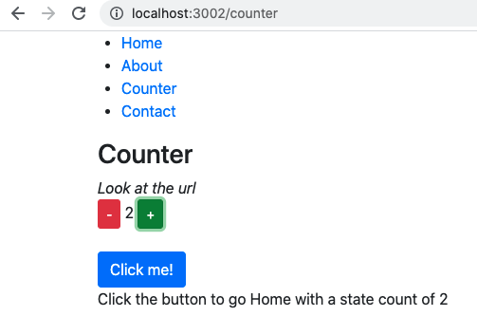
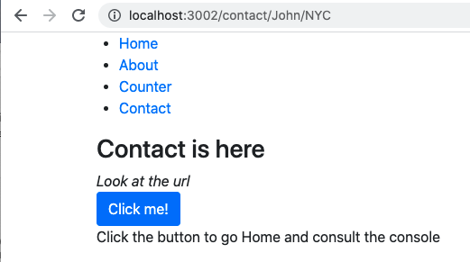
What will we build?
Passing data from Home to About as a parameter
John as a parameter
If the parameter is not John, stay on Home
Passing the value of the counter (state) back to Home
Passing data from Home to Contact as 2 parameters
Notes:
For each component does it have a state?

Slide 35
Code
https://github.com/tnt-summer-academy/Samples/tree/main/Stretch/router-javascript-demo
https://github.com/tnt-summer-academy/Samples/tree/main/Stretch/router-javascript-demo-skeleton (skeleton only)

Slide 36
PART 6 SECOND EXAMPLE

Slide 37
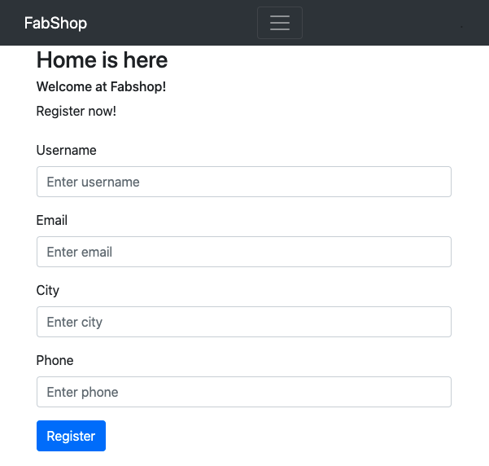
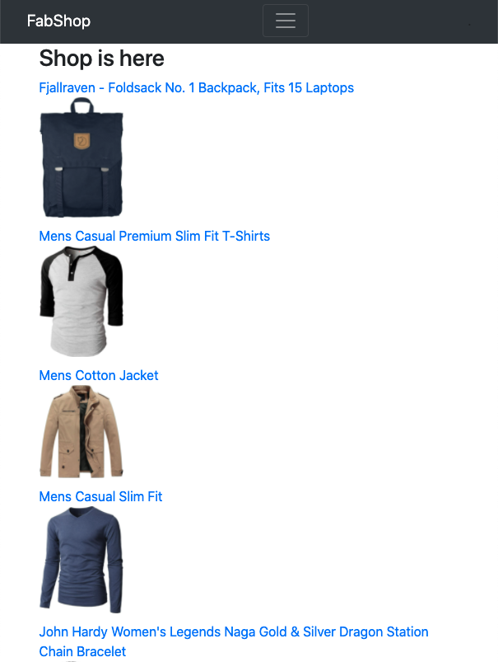
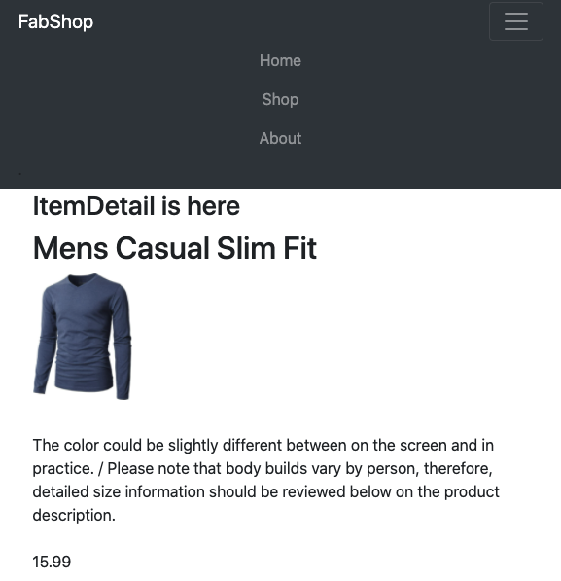
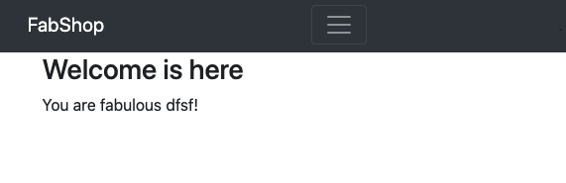

What will we build?
Load and display data from fakeStoreApi
Passing the id of the item to display the info of the item
Passing the value of the state (registration info) to Welcome
Notes:
For each component does it have a state?

Slide 38
Code
https://github.com/tnt-summer-academy/Samples/tree/main/Stretch/router-nav-demo

Slide 39
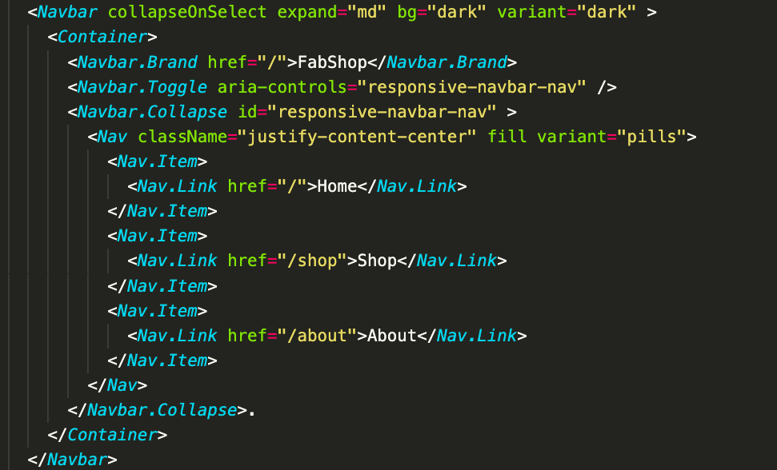
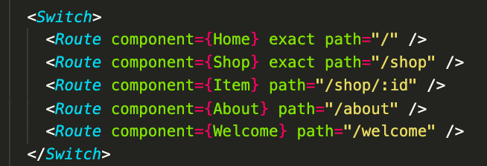
Navbar

Slide 40
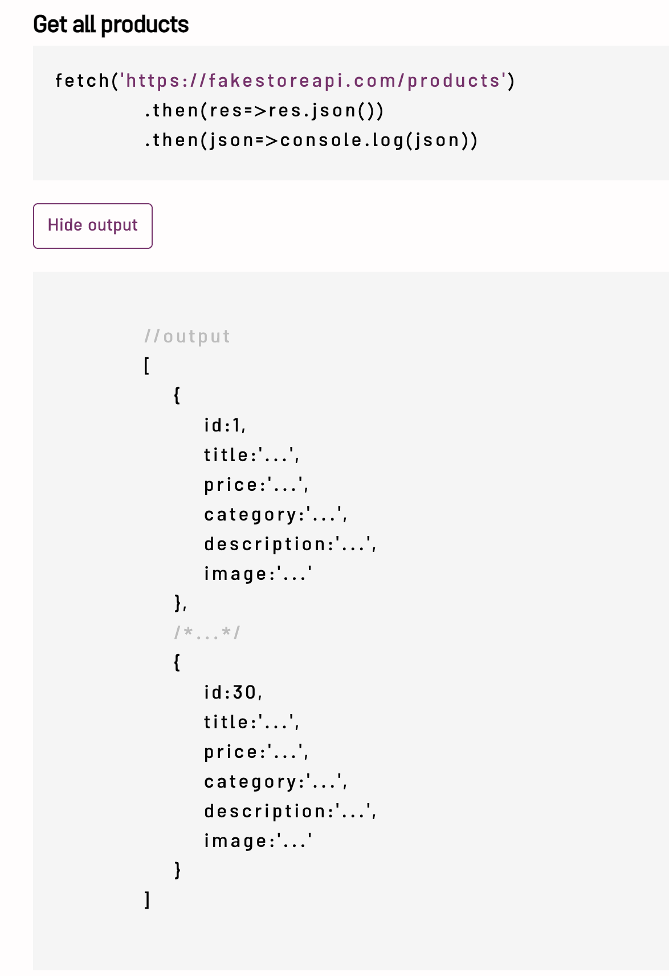
Let’s explore fakeStoreApi
https://fakestoreapi.com/docs

Slide 41

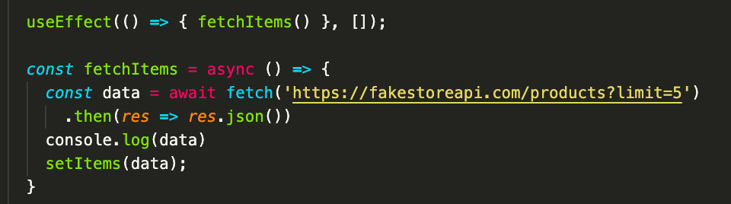
Fetching data from fakeStoreApi
Fetch 5 items and use sync and away
Update the state with the new list of items
useEffect runs fetch items once, when the component mounts

Slide 42
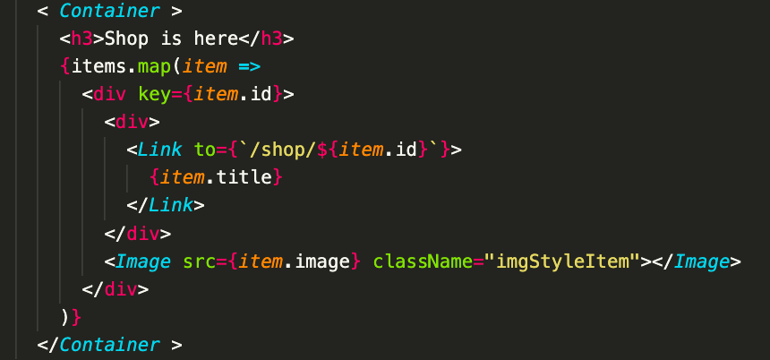
Displaying the items
Display the title and an image
Create a unique key for each item in the <div>
Map through the items
Link to each item

Slide 43
BREAK

Slide 44
PART 7
React Router 5 versus React Router 6

Slide 45
New version!
The new version of React Router is v6.
Here are some changes that were introduced in v6:
Enhanced path pattern matching algorithm. React Router has a better algorithm for loading the best route for a particular URL, the order of defining does not really matters now
Bundle size reduced by almost 58%
Switch is replaced by Routes
exact is not needed anymore
useHistory is replaced by useNavigate
Redirect is replaced by Navigate component

Slide 46
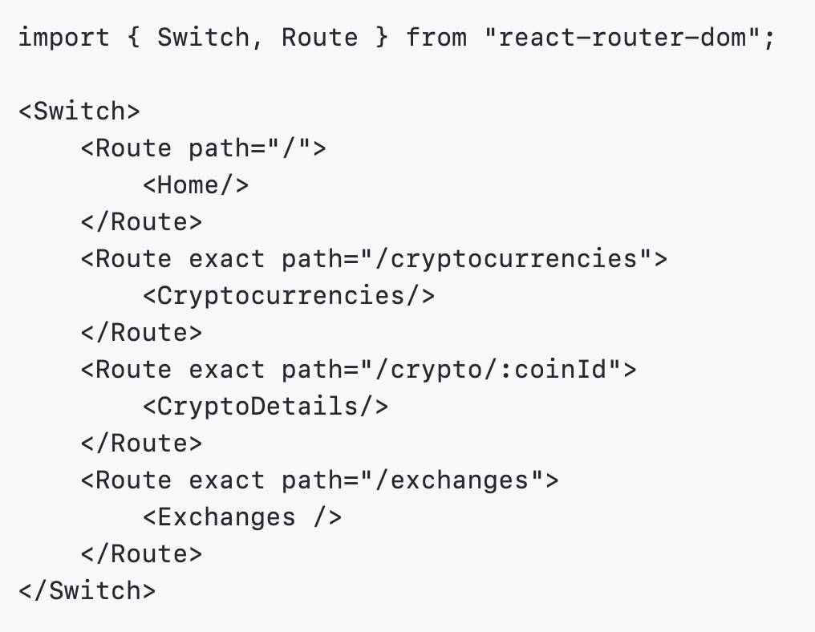
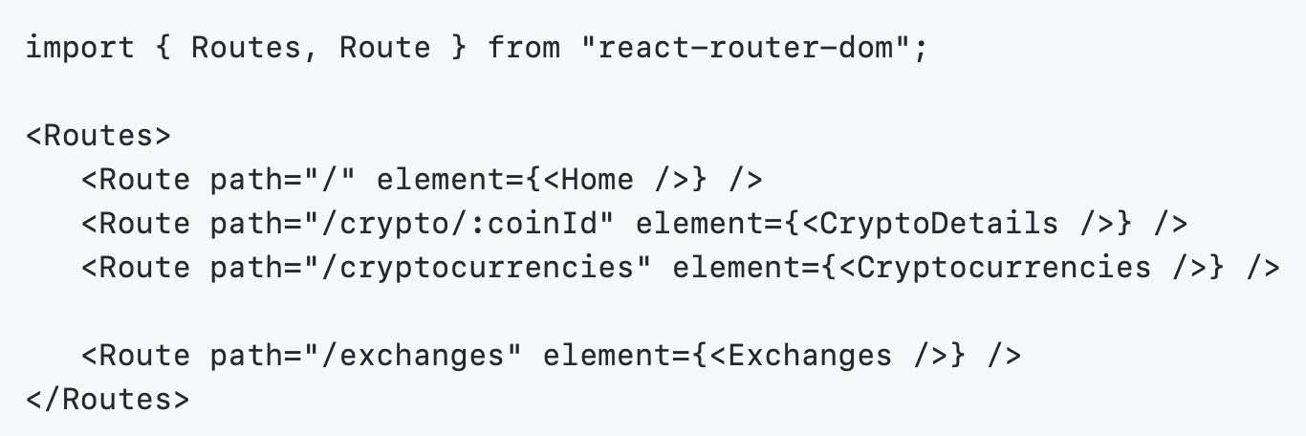
Switch -> Routes
v5
v6

Slide 47
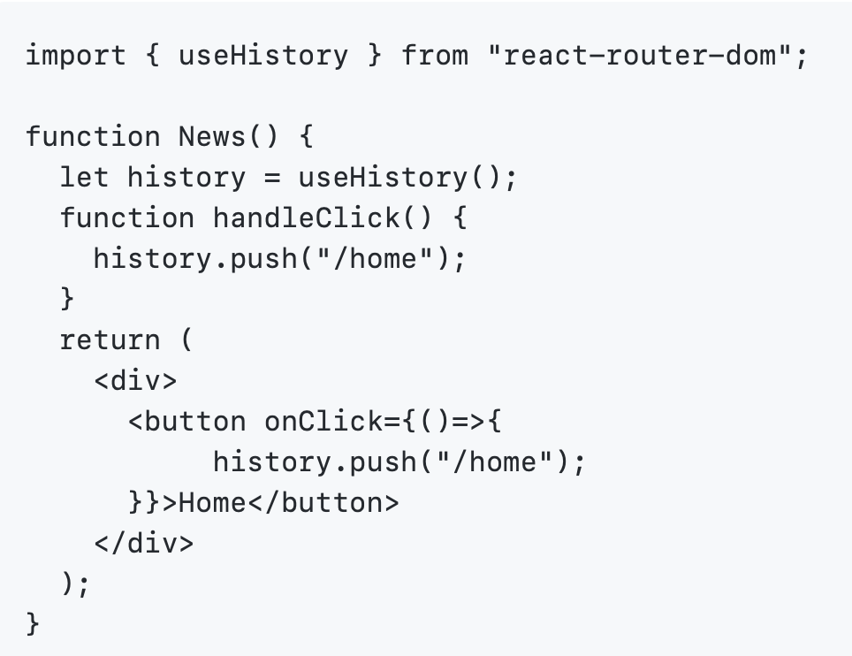
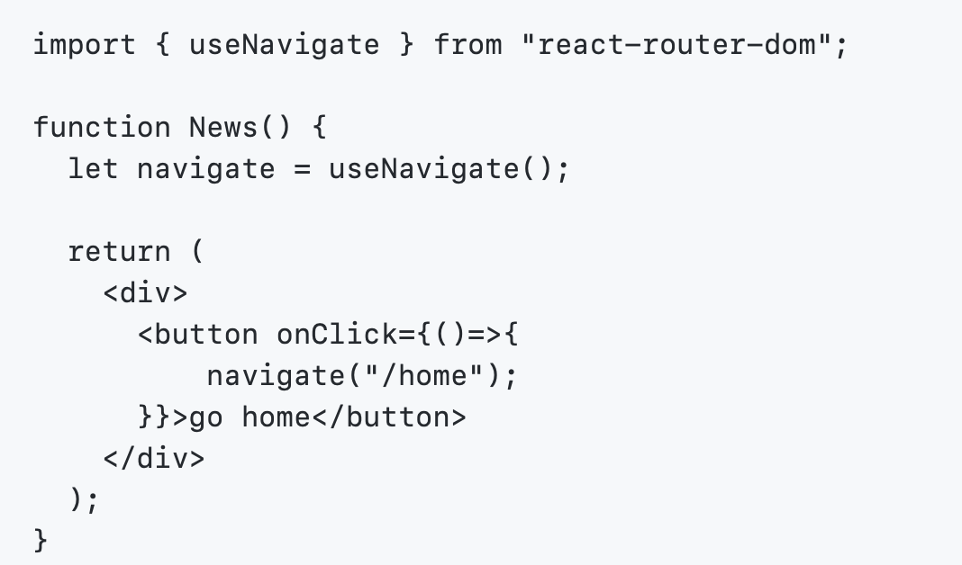
useHistory -> useNavigate
v5
v6

Slide 48
WORK IN YOUR TEAM
ASK QUESTIONS

Slide 49
Fun : Explore
https://picsum.photos

